Slide 1



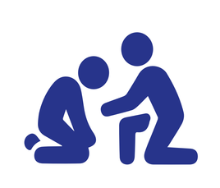



Safer Space Principles
A safer space is an environment where everyone can participate, be present, and express themselves without discrimination or harassment. The goal is to create a respectful, open, and accessible atmosphere that supports cultural experiences, learning, and a sense of community.
BE MINDFUL
Be mindful of everyone in the space or at the event. Be aware of different needs, backgrounds, and ways of participating.
GIVE SPACE, BE OPEN, AND LISTEN
Listen actively and give everyone the opportunity to participate in conversations or activities in their own way. Everyone has the right to express themselves without being belittled or labeled.
RESPECT
Treat everyone equally and with respect. Do not make assumptions about people’s backgrounds, identities, or experiences. Respect privacy and approach sensitive topics with care.
APOLOGIZE AND FORGIVE
If you hurt or offend someone, intentionally or unintentionally, apologize and be willing to reflect on and adjust your behavior. Be kind to yourself and others; everyone is learning.
BE RESPONSIBLE
Take responsibility for your words and actions. Remember that even well-intentioned comments or behavior may affect others in unintended ways.
If you take photos or videos, make sure to get consent from everyone appearing in them.
INTERVENE IN HARASSMENT
If you notice inappropriate behavior or harassment, report it to the person responsible for the venue or event. Everyone has the right to a safe cultural experience.
A Shared Commitment
Cultural actors in Varkaus are committed to developing safer space practices together with their community and fostering an environment where everyone feels safe and welcome.
Safer Space Coordinator for this venue/event:
Contact information:
pn

